Slide 1


TECHFUSION
ADAPTED AI
Personalized Learning That Adapts to Every Student
Theme - Smart Education.
Problem Statement - PS1 - Personalized AI Learning Assistant.
Team Name – SkillMatix.
Team members name –
  Rutuja Deshmukh
  Rajshree Patil
  Manthan Hingmire.
  Prathamesh Gadakh.
College name - MET Bhujbal Knowledge City, Institute of Engineering.

Slide 2
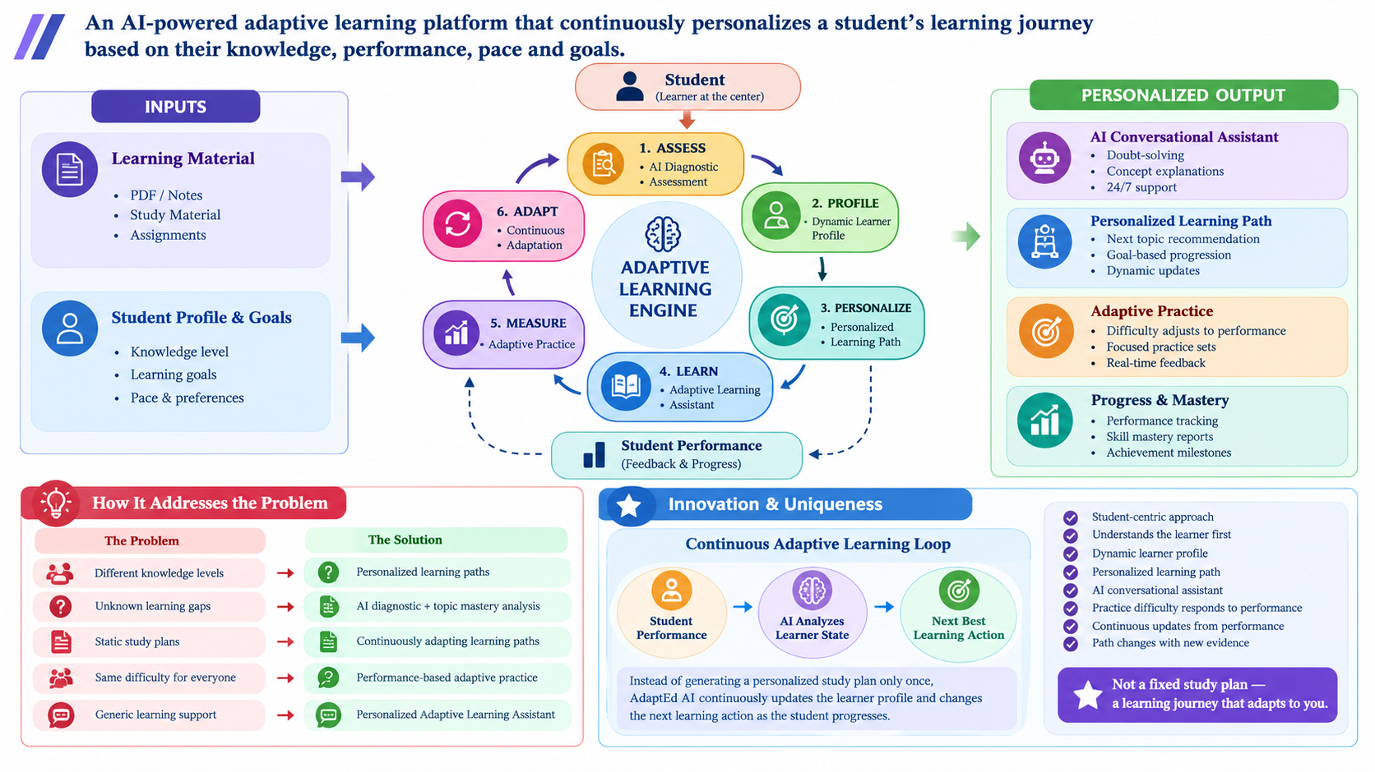
IDEA TITLE

Slide 3
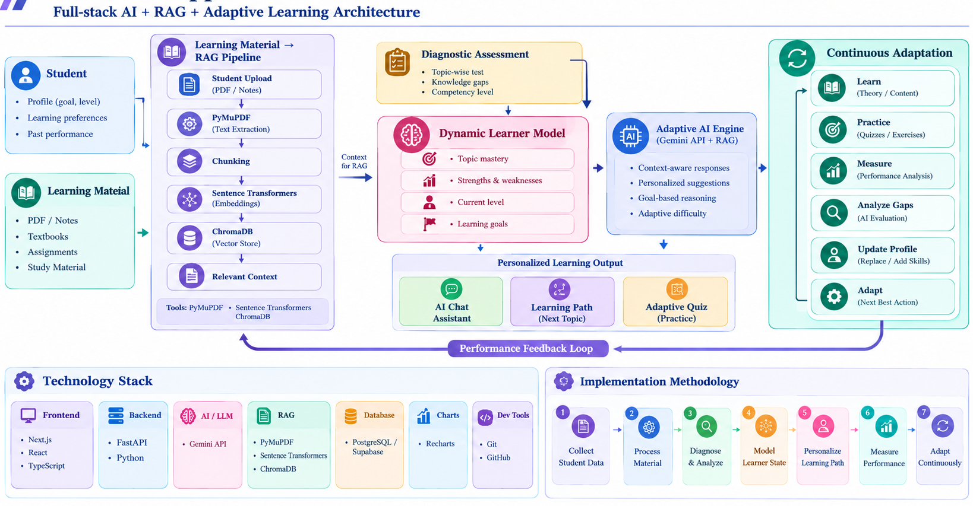
TECHNICAL APPROACH

Slide 4
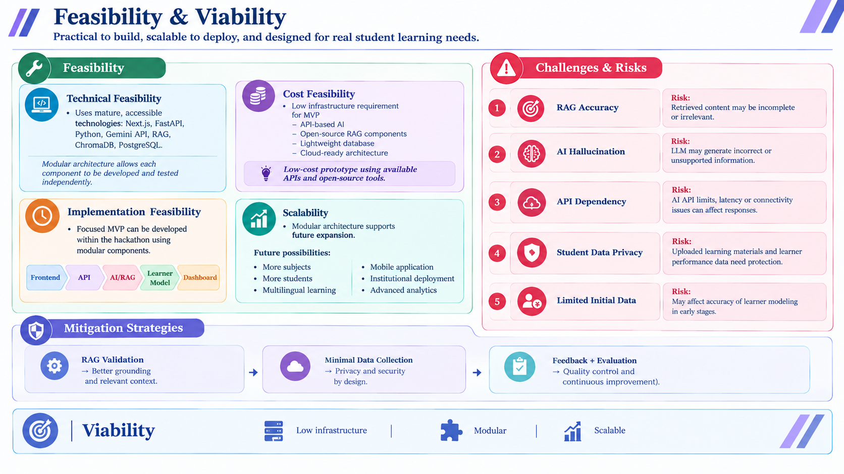
FEASIBILITY AND VIABILITY

Slide 5
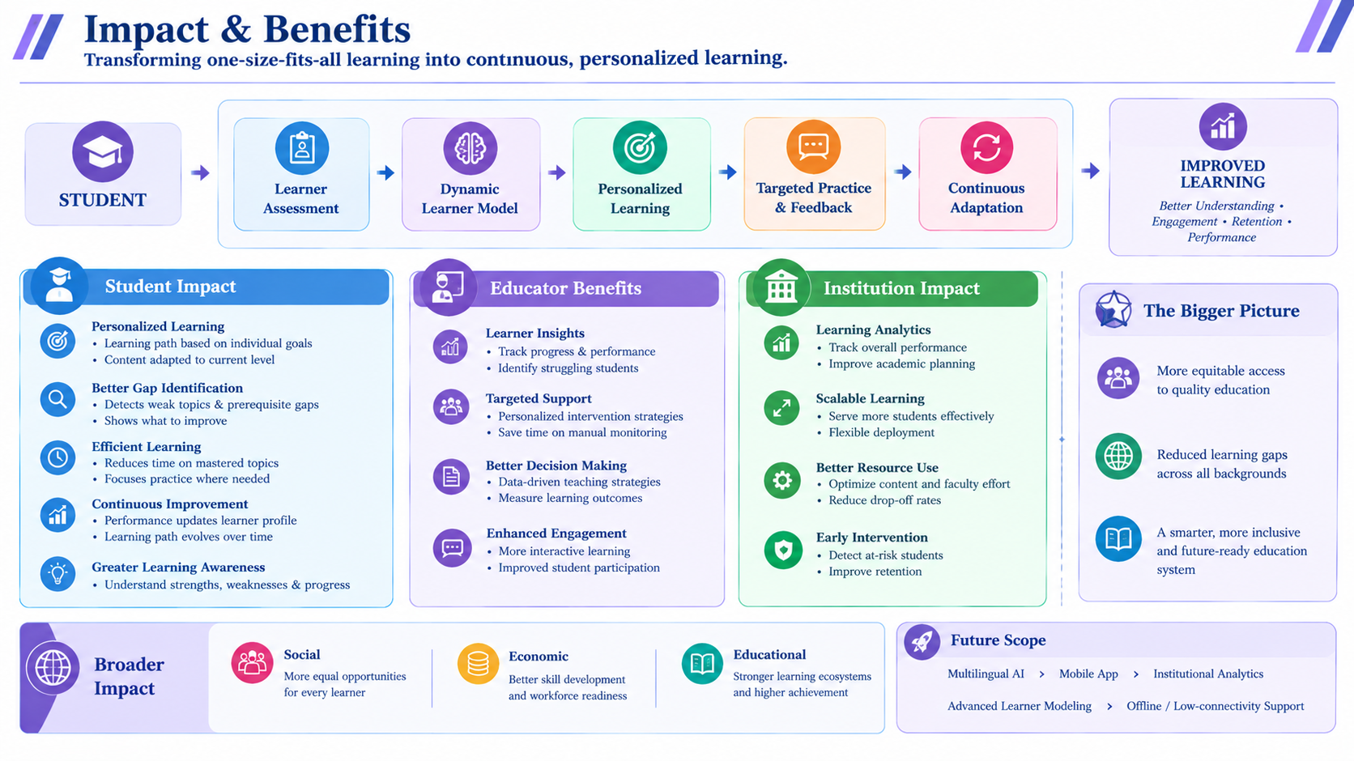
IMPACT AND BENEFITS

Slide 6
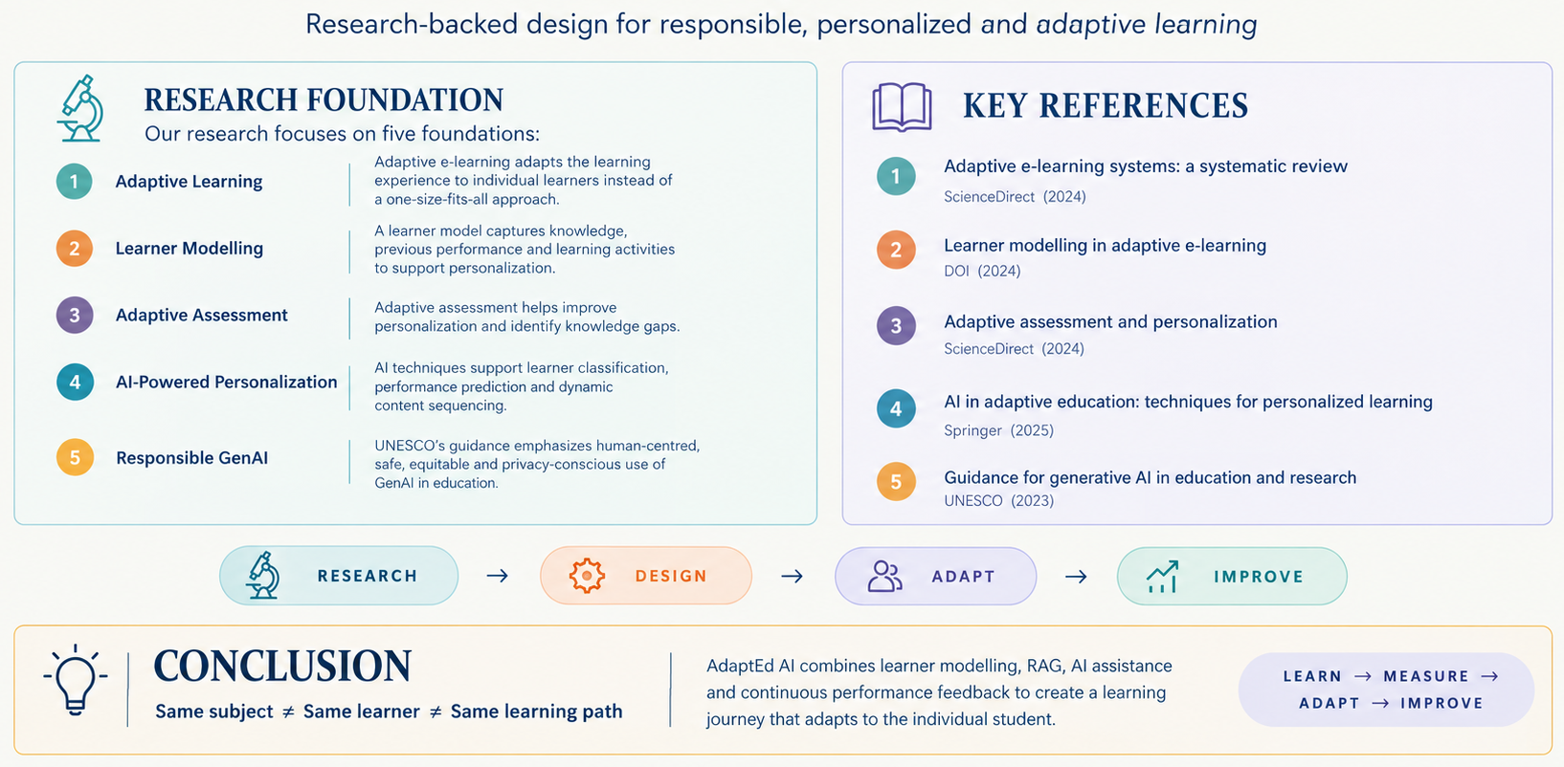
RESEARCH AND REFERENCES

